Slide 1

SWINGS FRAMEWORK (FRONT-END DESIGNING)

Slide 2
Java Swing:
Java Swing tutorial is a part of Java Foundation Classes (JFC) that is used to create window-based applications. It is built on the top of AWT (Abstract Windowing Toolkit) API and entirely written in java.
Unlike AWT, Java Swing provides platform-independent and lightweight components.
The javax.swing package provides classes for java swing API such as JButton, JTextField, JTextArea, JRadioButton, JCheckbox, JMenu, JColorChooser etc.

Slide 3
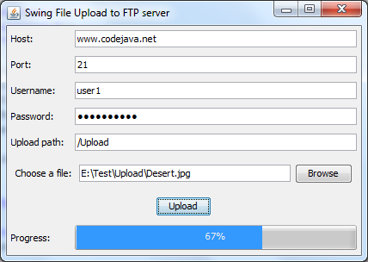
Example of swing application

Slide 4
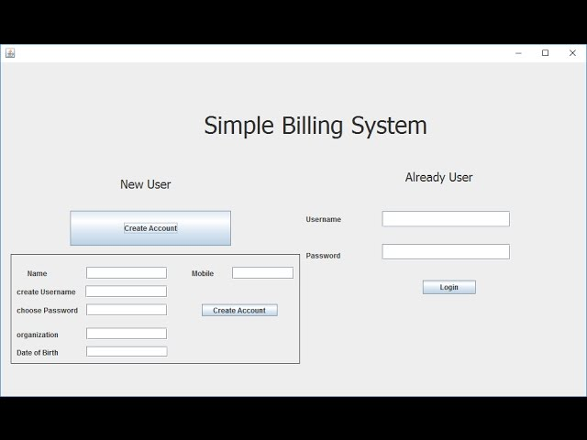
Example of swing application

Slide 5
Container class:
Any class which has other components in it is called as a container class. For building GUI applications at least one container class is necessary.
Following are the three types of container classes:
Panel – It is used to organize components on to a window
Frame – A fully functioning window with icons and titles
Dialog – It is like a pop up window but not fully functional like the frame

Slide 6
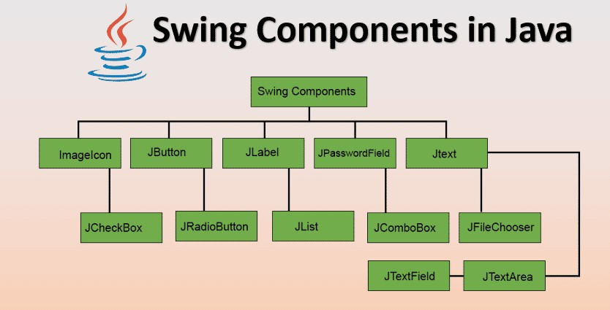
Java Swing components:

Slide 7
Java classes for swing components:
JButton class
JRadioButton class
JTextArea class
JComboBox class
JTable class
JColorChooser class
JProgressBar class
JSlider class

